Slide 1

Smart contract development using Solidity

Slide 2
Introduction to smart contracts
Act as normal contract but fully digitise.
Collection of code that resides on an address (CA)
Properties
Self verifying
Self executing : Remove third party
Written in HLL and compiled into bytecode.
Resides on blockchain in bytecode format

Slide 3
HLL to write smart contracts
Solidity : similar to javascript
Serpent : similar to Python
Lisp Like Language (LLL) : similar to Assembly

Slide 4
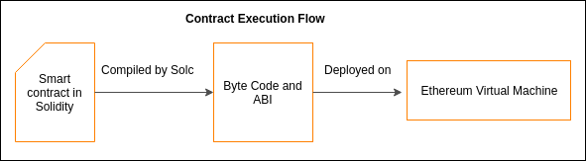
How does it works?

Slide 5
Solidity - v0.4.24

Slide 6
Basic Data Types - Integer, Bool
Value types : Passed by value
Boolean
Operators : !, ||, &&, ==, !=
Default : false
Integer
int / uint : signed or unsigned of various types
Operators:
Comparison : >,>=,<,<=,==,!=
Bitwise : &, |, ^,~
Arithmetic : +, *, %, /, - , ** , <<, >>
Default 0

Slide 7
Basic Data Types - Address
address
Holds 20 byte value
Initialize by 0x0
Members
Balance : query balance
Transfer : send ether, throws on failure
Send : send ether, return false on failure ; DANGER

Slide 8
Complex Data Types - Arrays 1
Array
Fixed-sized arrays
Created by specifying the type and size
Ex. bool [10] array, int8[10] array
Dynamic-sized
Created by specifying the type
Ex. int8[] arrayInt, bool[] arrayBool
new operator for allocating memory. Ex. arrayInt = new int8[](10);

Slide 9
Complex Data Types - Arrays 2
Special Array
Byte & Bytes
byte[15] data : static
byte [] data : dynamic
bytes1 data = byte [1] data
bytes32 //32 byte array
bytes1, bytes2, ….. bytes32
String
Not a basic type
Dynamically sized
Fixed length not supported, like string[7] //error
Member .length is not present as well

Slide 10
Complex Data Types - Mapping, Enum
Mapping
Similar to hashtable or dictionary object : key-value pair
Allowed as storage or state variable
E.x. mapping(address => uint) balances;
Not iterable : can not loop through
Enum
User defined types with finite set of values
Ex. enum gender {MALE, FEMALE, OTHER}
Not a part of ABI

Slide 11
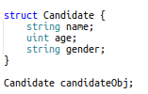
Complex Data Types - Struct
Struct
User defined types declared with keyword struct.
Can group several types
Can not have members of its own types
Can be contained in array and mapping
Not part of ABI

Slide 12
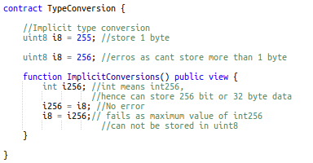

Type Conversion
Implicit
Compiler allows if no data loss
Explicit
Loss of information

Slide 13
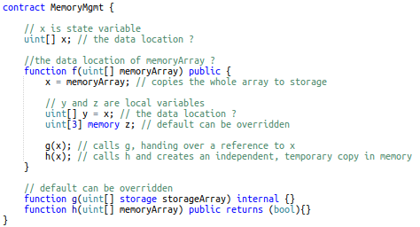
Data Location
Complex types need memory for storage of data. Depending upon their context, EVM logically divides the memory into 3 regions:
Storage
Persistence/ Permanent
Read and Write operations are costly.
State variables, Local variables by default
Memory
Non persistence / Temporary
Cheap as compared to Storage
Function args and return params by default
Calldata
Non persistence / Temporary
Non Modifiable
Used in function calls

Slide 14
Visibility
Private
Visible in the contract its defined, not even from derived contract
Public
Visible from within and outside
By default functions are public
For public state variables, compiler automatically creates Getter method
Internal
Accessed from within the contract and contract deriving from it.
State variables are internal by default
External
Called from other contract (using its address) or by itself by message call

Slide 15
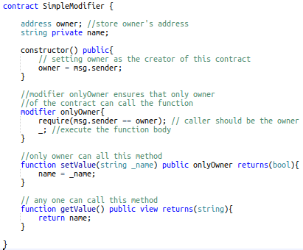
Function Modifiers
Re-executable piece of code
Helps to change behaviour of a function
Check certain conditions before even executing the function
Hence can reject the function call.
Can have arguments just like methods have
Payable, view, pure are inbuilt modifier

Slide 16
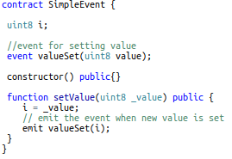
Events
Used to capture log
Implemented using event keyword
Event can be emitted by smart contract using emit keyword
Once the transaction mined, logs in all nodes gets updated
Dapps can watch these events

Slide 17
Keywords : View, Pure
View
Allowed to read the storage variables.
Can not change the state of contract.
Pure
Can not even read storage variables.
Can not change the state of contract

Slide 18
Keywords : Fallback, Payable
“Well, try to learn yourself?”

Slide 19
Error Handling
No try-catch
revert()
Throws an exception
Refunds the unused gas
Abort execution and revert state changes
require(condition)
If condition is not met, then throw exception
Unused gas returned
assert(condition)
If condition is not met, then throw exception
All gas consumed
Runtime exceptions, like divide by 0

Slide 20
Interface, Library, Inheritance
Interface
Function can’t have implementation
Can’t have constructor, variable, struct, enum, can’t inherit interface or contract
Inherited class must implement all methods of interface
Starts with interface keyword.
Library
Similar to contract
Starts with library keyword
Can write all structs, enums and use it anywhere in the project.

Slide 21
References
http://www.ethdocs.org/
https://github.com/ethereum/wiki/wiki/Useful-%C3%90app-Patterns
http://solidity.readthedocs.io

